Slide 1
EEET2610 – Engineering Design 3
Team F
- Truong Tan Gia Huy – s3806881
- Pham Trinh Hoang Long – s3879366
- Tran Thanh Tu – s3957386
- Huynh Ngoc Duy – s3924704
- Mina Jeon – s3764040
- Vu Thien Nhan – s3810151
- Tran Truong Son – s3818468

Slide 2
— Project Demonstration
Self-balance Quadcopter

Slide 3
—
Self-balance Quadcopter
CAD MODELLING
PCB DESIGN
MECHANICAL ASSEMBLY
PID CONTROLLER
REMOTE CONTROLLER
GPS TESTING

Slide 4
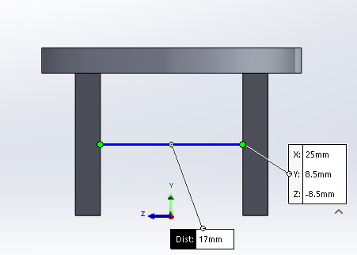
CAD MODELLING
Figure 1: 3D CAD model for motor holder in Solidworks
Figure 2: CAD model in front view
All dimensions are carefully designed in case of tolerance.

Slide 5
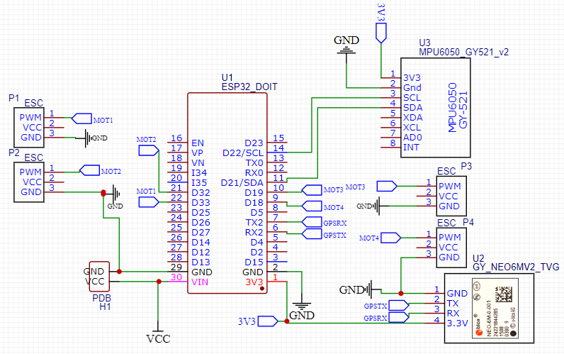
PCB DESIGN
Figure 3: Drone PCB Schematic design EasyEDA software

Slide 6
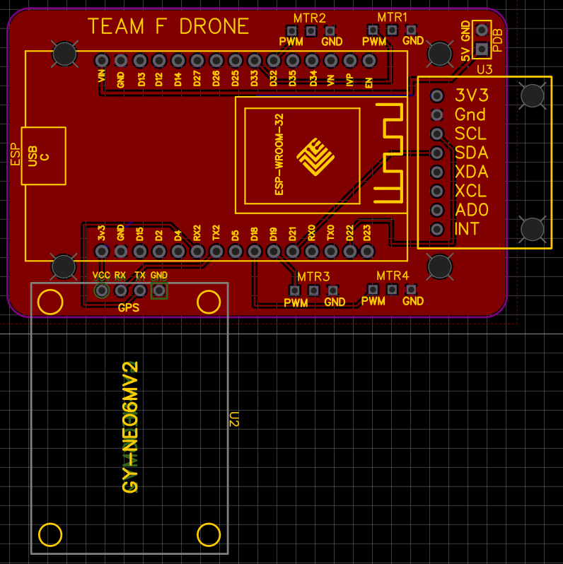
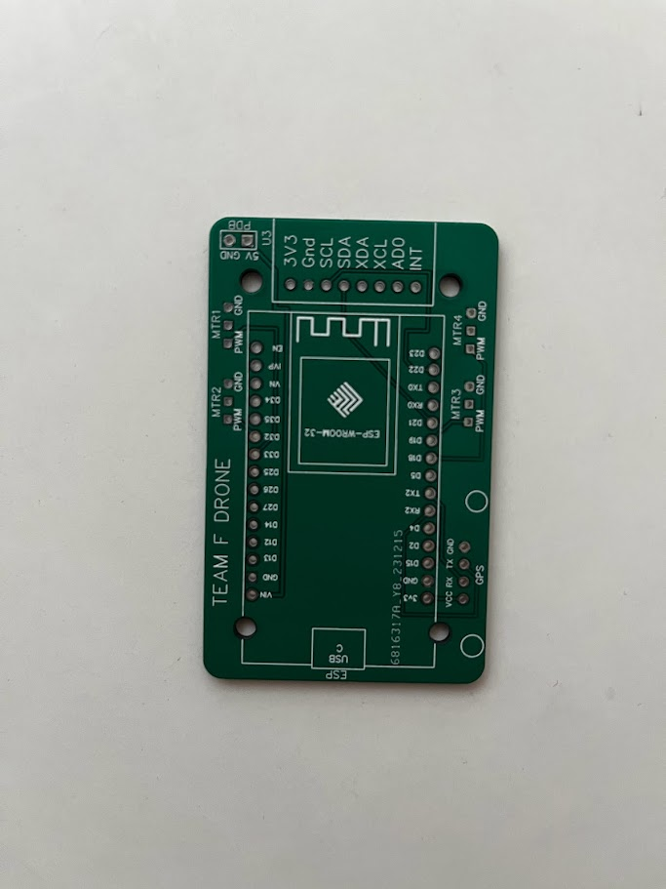
PCB DESIGN
Figure 4: Drone PCB design in EasyEDA software
Figure 5: Drone PCB in real life

Slide 7
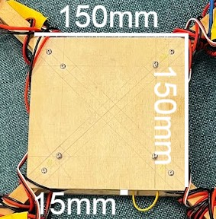
Mechanical Assembly

Slide 8
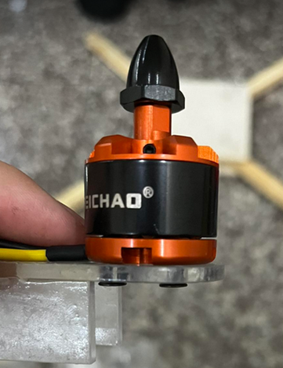
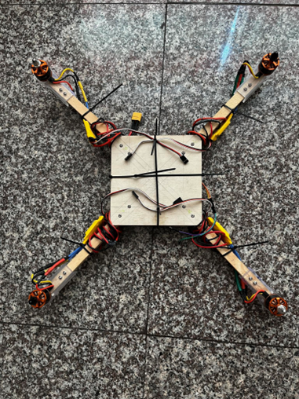
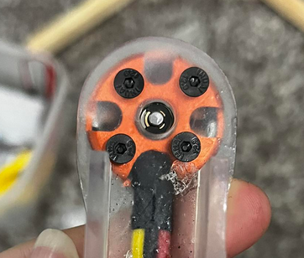
Mechanical Assembly

Slide 9
Maximizing Efficiency with High Heat
Chosen Temperature: 475°C for soldering.
Reason for High Temperature: Wires and component are designed to withstand high temperatures .
Advantage: Maximizes soldering speed.
Key Benefit: Efficient progress without compromising wire integrity.
Notice: An important observation from my soldering project was that while most components were compatible with the chosen temperature settings, some required special attention

Slide 10
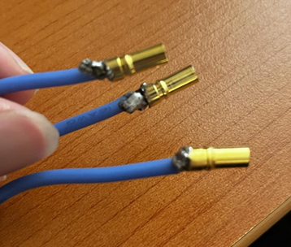
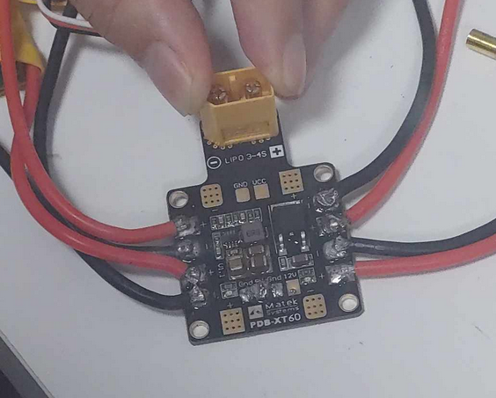
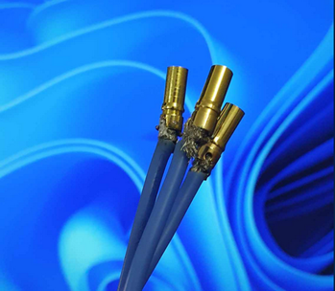
Soldering

Slide 11
Understanding and Implementing PID Control for Drone Stabilization
The PID controller helps maintain the drone's orientation by adjusting motor speeds based on sensor inputs.

Slide 12
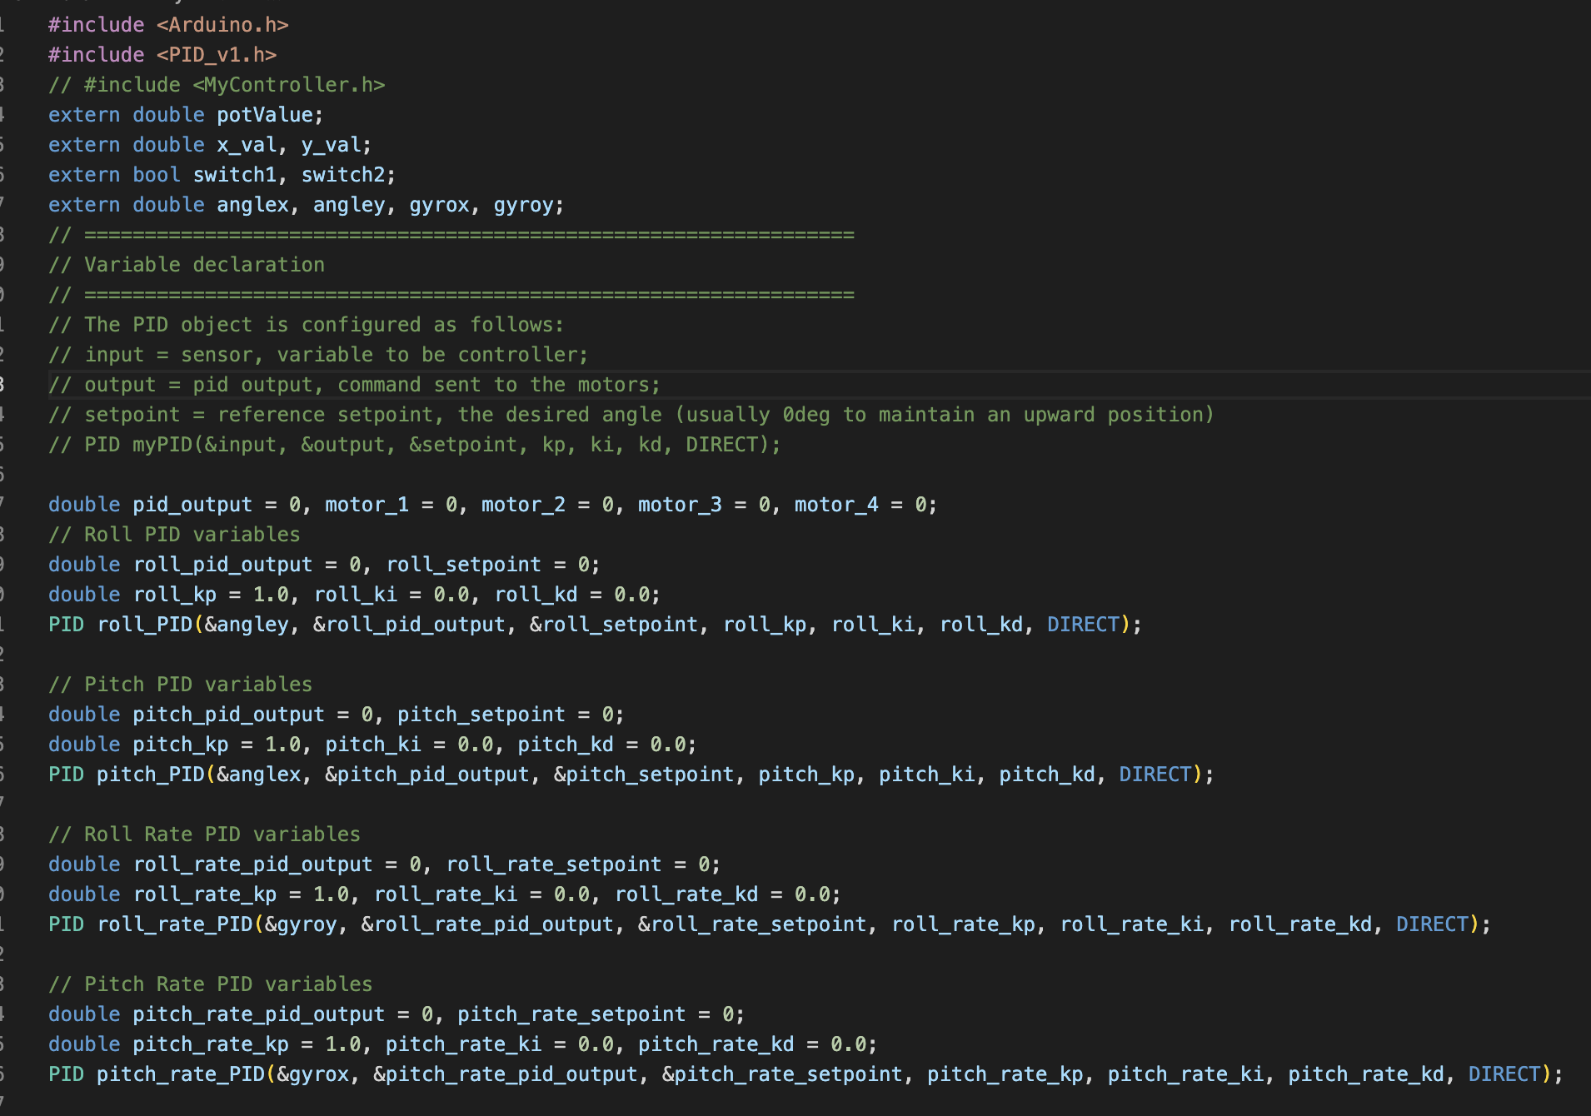
Understanding and Implementing PID Control for Drone Stabilization
Variable Declaration

Slide 13
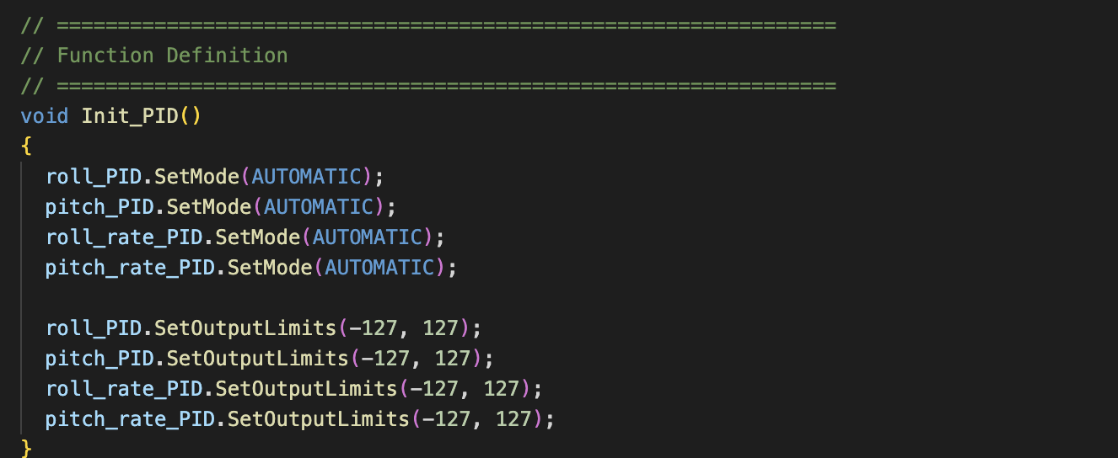
Understanding and Implementing PID Control for Drone Stabilization
Initializing PID

Slide 14
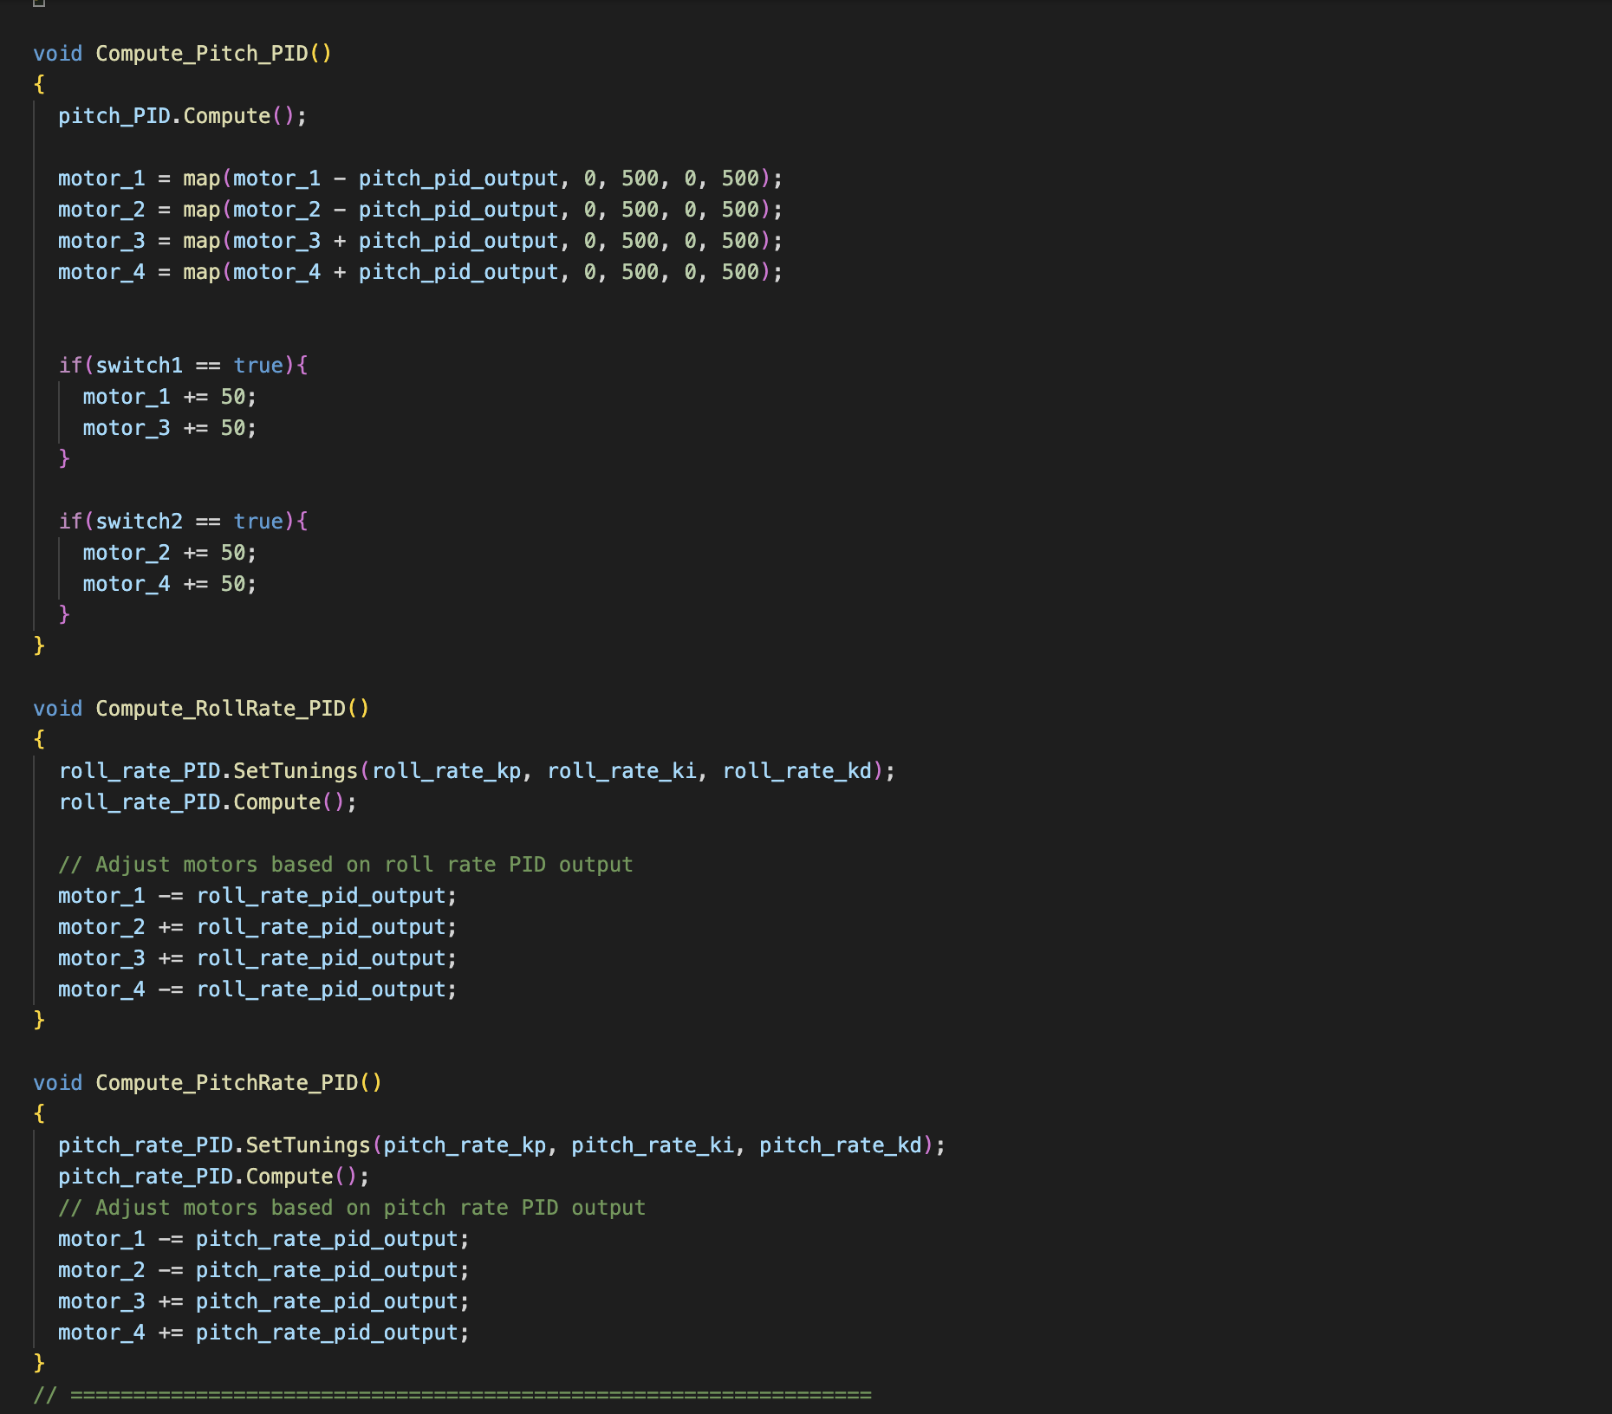
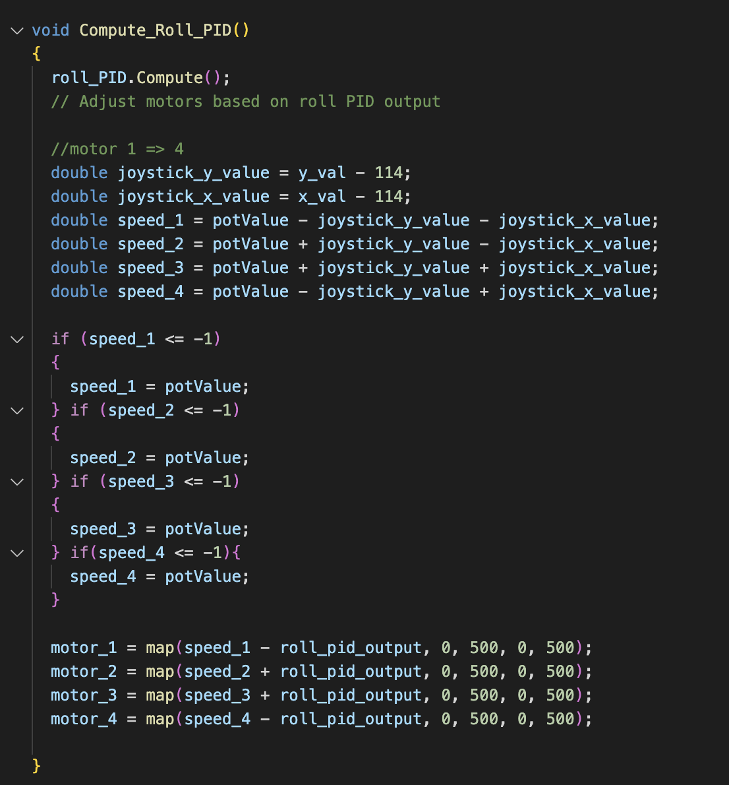
Understanding and Implementing PID Control for Drone Stabilization
PID Computation Functions

Slide 15
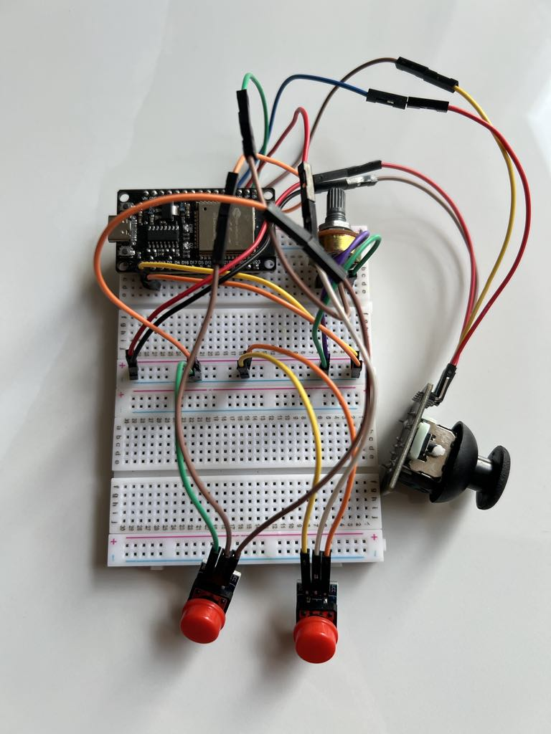
Remote Controller
The remote controller is based on joystick to control the pitch and roll of the drone.
The yaw rate is controlled with two push buttons.
The thrust is controlled with potentiometer.

Slide 16
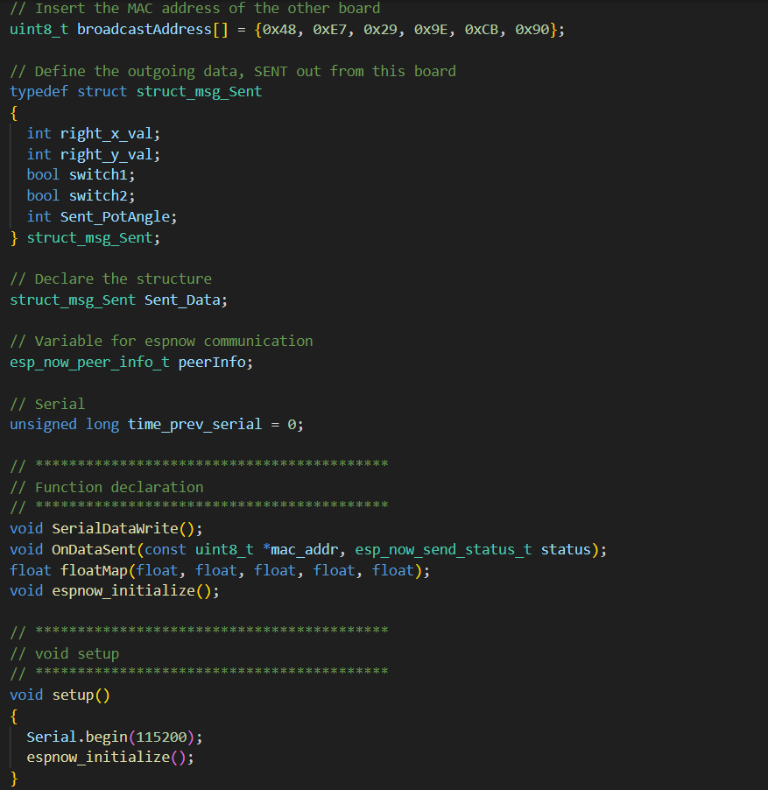
Remote Controller
Variable declaration

Slide 17
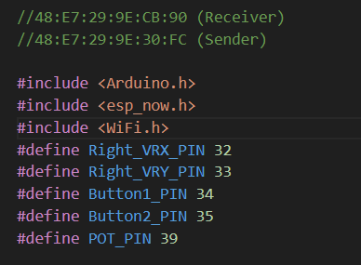
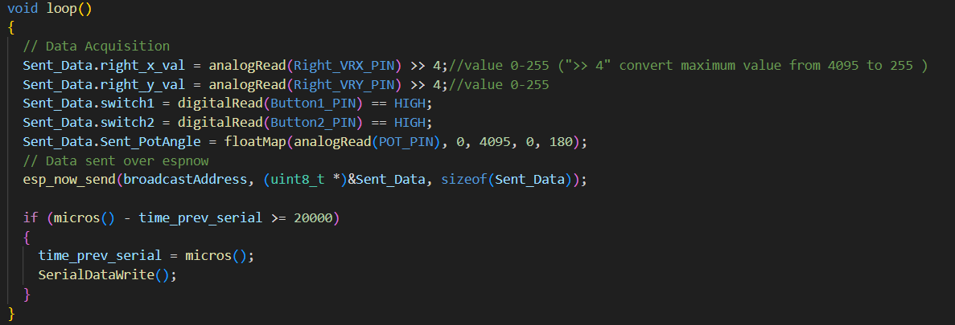
Remote Controller
The code for the controller, pinout defined and print out the value of each component.

Slide 18
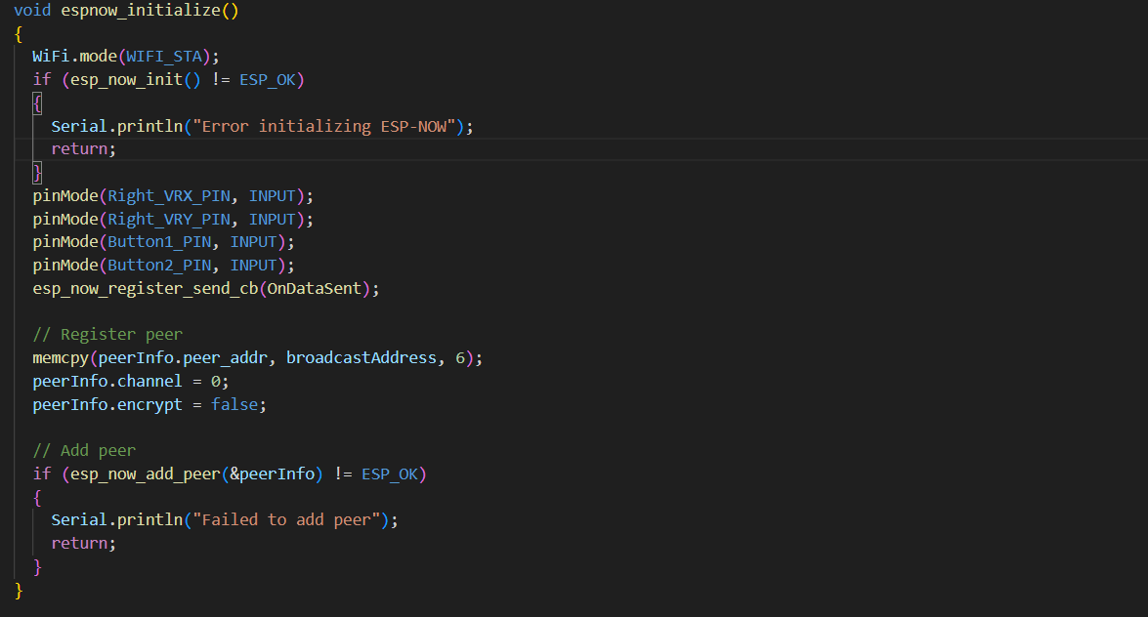
Remote Controller
ESPNOW Initialization

Slide 19
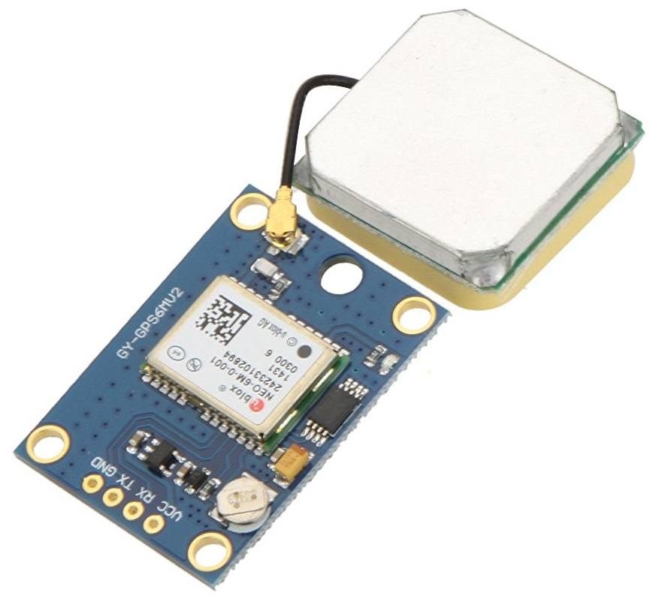
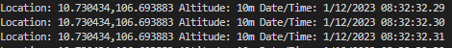
GPS Testing
Output to terminal: Location: 10.730434,106.693883 Altitude: 10m Date/Time: 1/12/2023 08:32:32.25

Slide 20
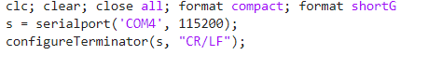
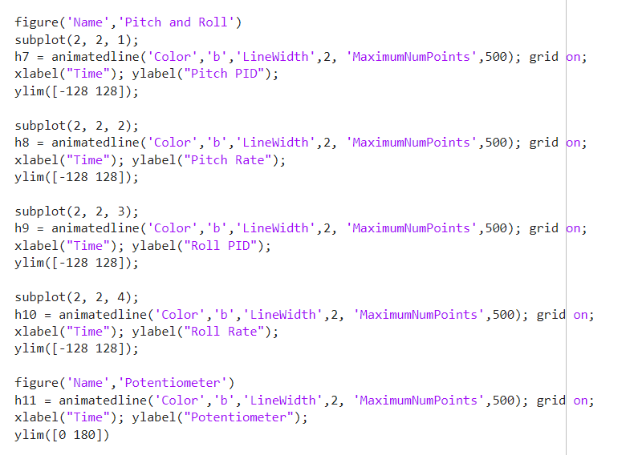
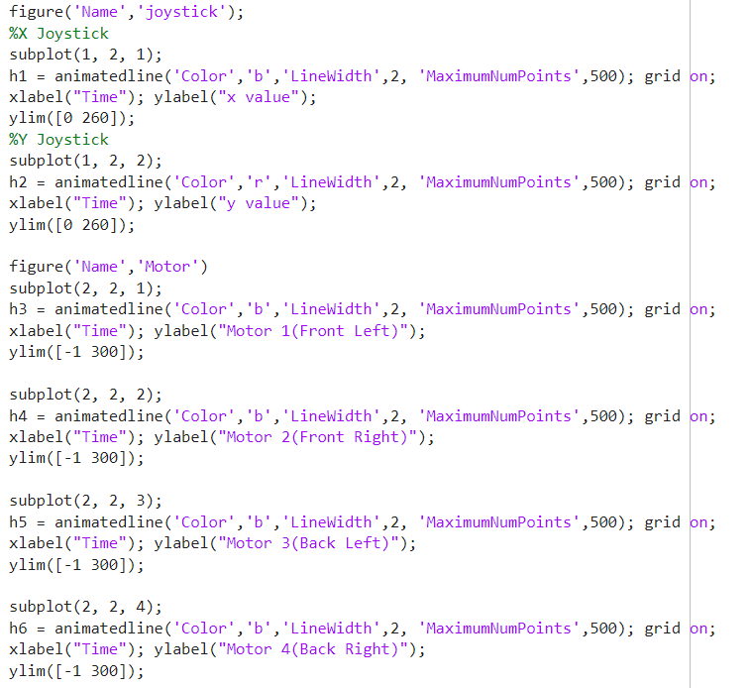
MATLAB Visualization
Port Declaration
Add windows and declare information into it

Slide 21
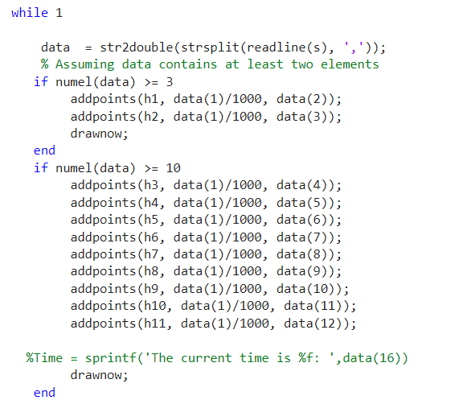
MATLAB Visualization
Draw loop

Slide 22
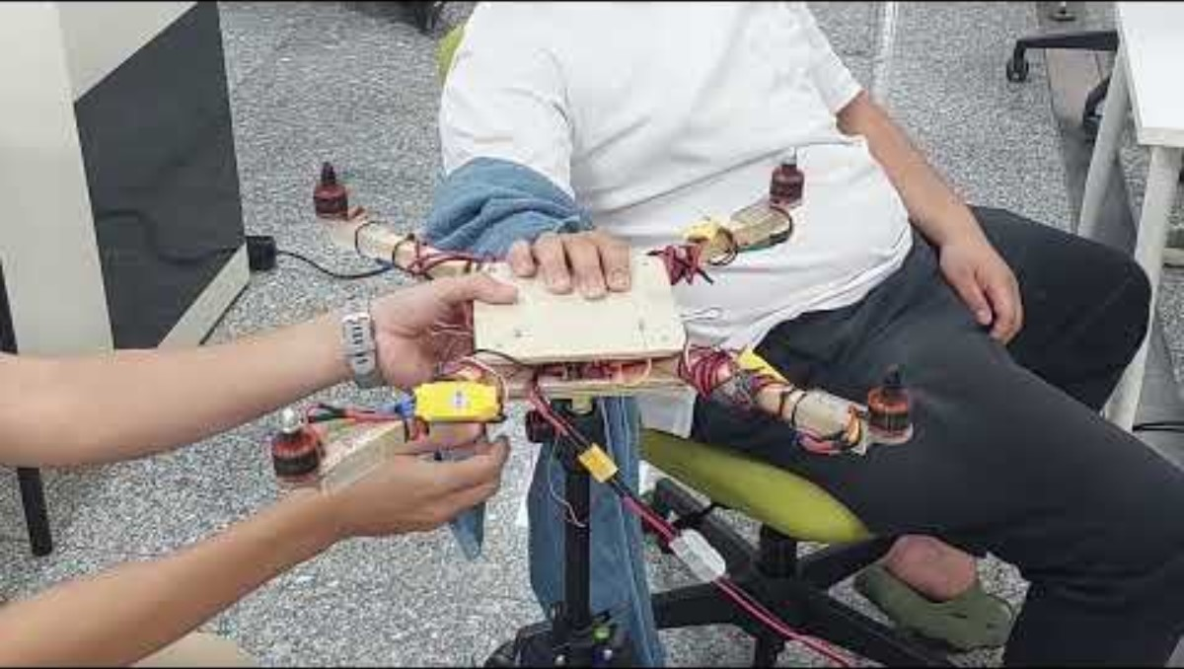
Experimental Protocol

Slide 23
— Thank you

